Slide 1
Control Systems
EE 447 Fa19 TuTh 12:30—2:20p DEN 303
Prof Burden
(Sam; he/him/his)

Slide 2
why take this course?

Slide 3
This course focused on analysis and design of (linear) feedback control systems.
You learned to understand and engineer control in robotics, embedded systems, electrical circuits, power systems, and biology.
We built on your background in calculus, signal processing, and linear algebra, providing new analytical and computational tools.

Slide 4
learning outcomes
it’s the end of the course – you (should) be able to:
represent a linear system in state space and transfer function form;
determine the effects caused by including feedback in a system;
linearize a nonlinear system around an operating point;
determine if a system is stable;
understand sensitivity and noise/disturbance rejection properties;
apply scientific computing tools to model, design and simulate systems;
determine the performance of a system analytically and from simulation;
apply root locus, frequency response and full-state feedback methods to design a feedback control system to meet performance requirements;
design a full-state observer for a system;
apply observer + controller to estimate and stabilize a system’s state.

Slide 5
what’s next?

Slide 6
coursework
448/449: capstone design
458: Power electronics controls
466: Neural computation and engineering laboratory
547: Advanced linear control systems
548: Linear multi-input / multi-output
549: State estimation and system identification
550: Optimal control
552: Power systems control
570: Geometric control
582: Digital control
583: Nonlinear control
585: Adaptive control
593: Feedforward control
594: Robust control
597: Network control

Slide 7

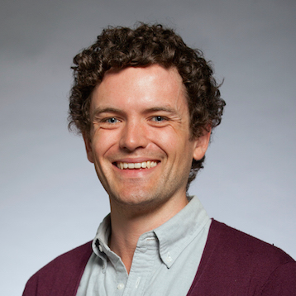
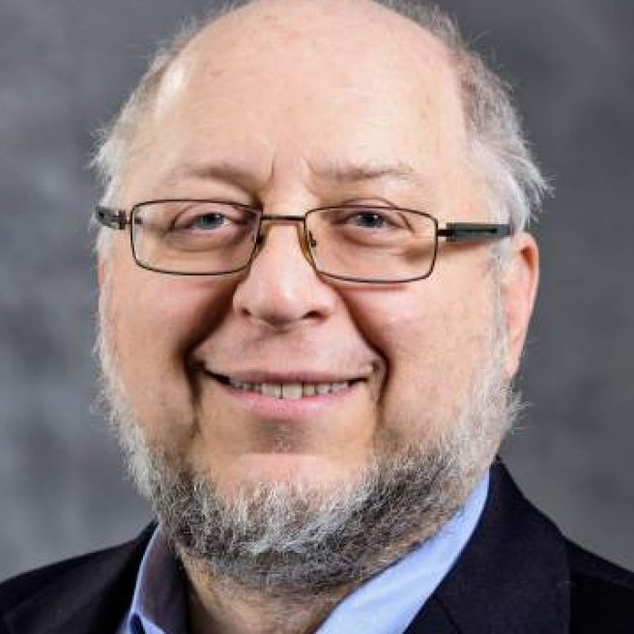
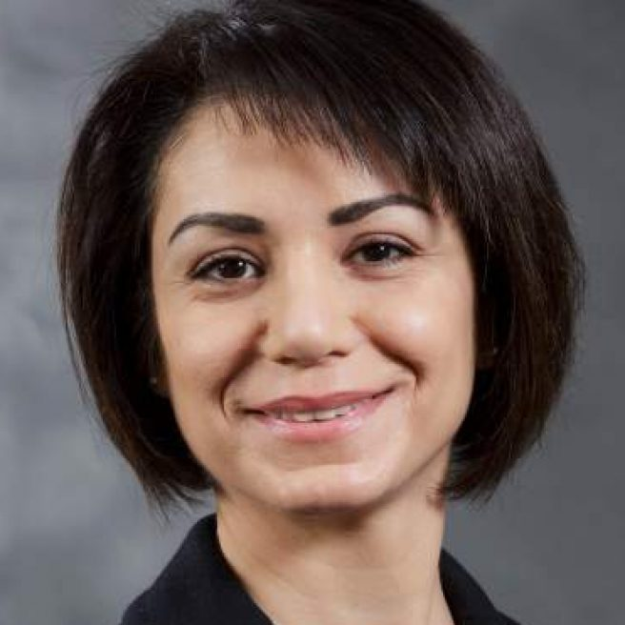
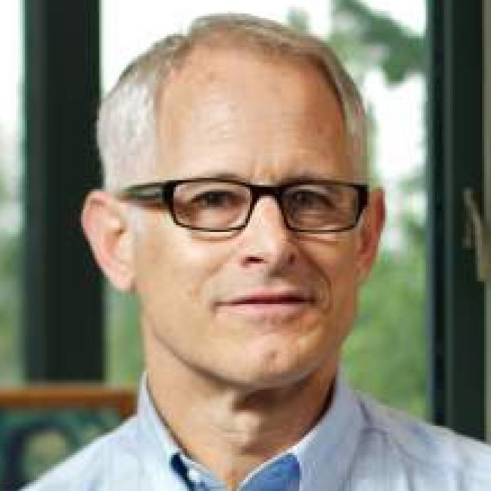

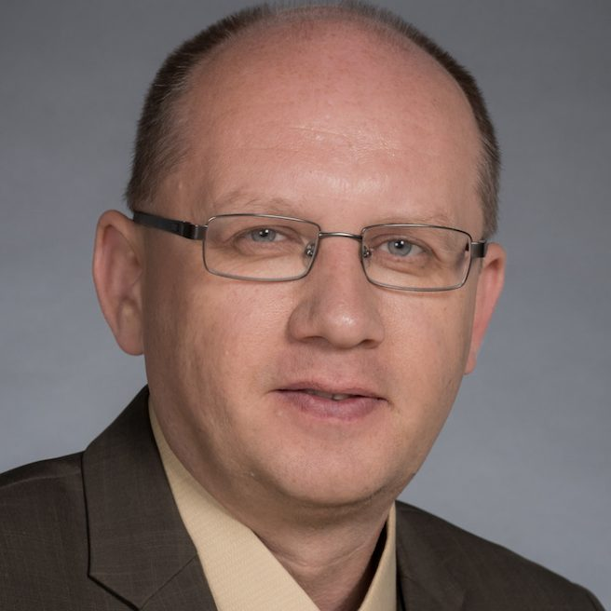
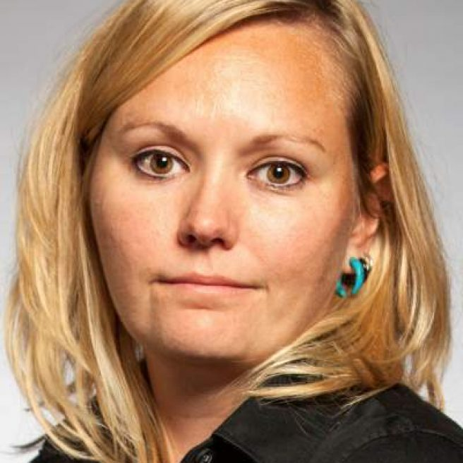
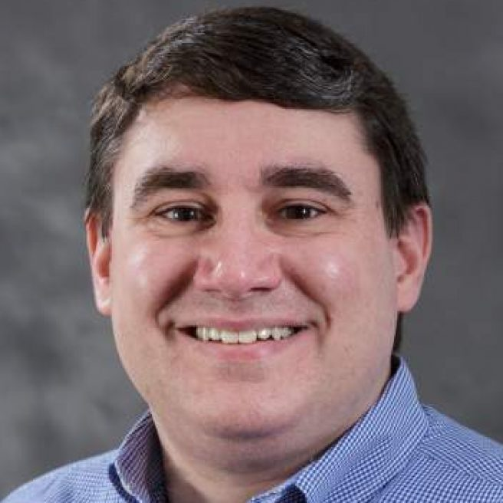
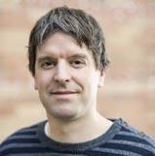
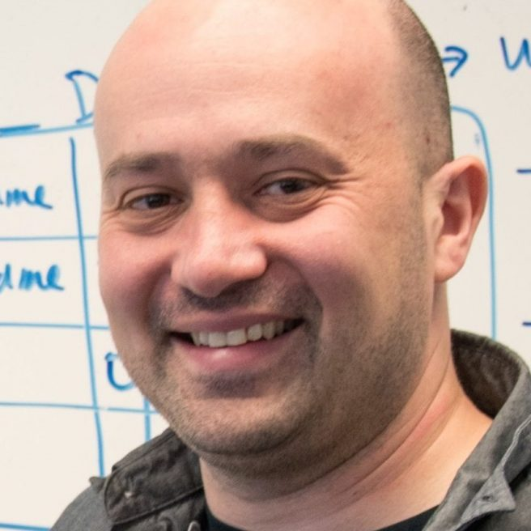
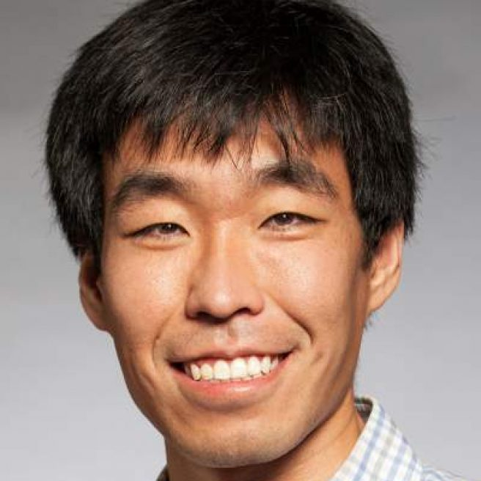
research
Prof. Linda Bushnell | networked control, cyber security
Prof. Sam Burden | sensorimotor control
Prof. Howard Chizeck | brain-computer interface (BCI)
Prof. Maryam Fazel | convex optimization
Prof. Blake Hannaford | medical robotics, telerobotics
Prof. Eric Klavins | systems biology
Prof. Alex Mamishev | sensor design and integration
Prof. Lillian Ratliff | cyber-physical systems (CPS)
Prof. Matt Reynolds | ultra-low power sensing, computation
Prof. Georg Seelig | systems biology
Prof. Eli Shlizerman | data-driven dynamical systems
Prof. Baosen Zhang | cyber-physical systems (CPS)

Slide 8

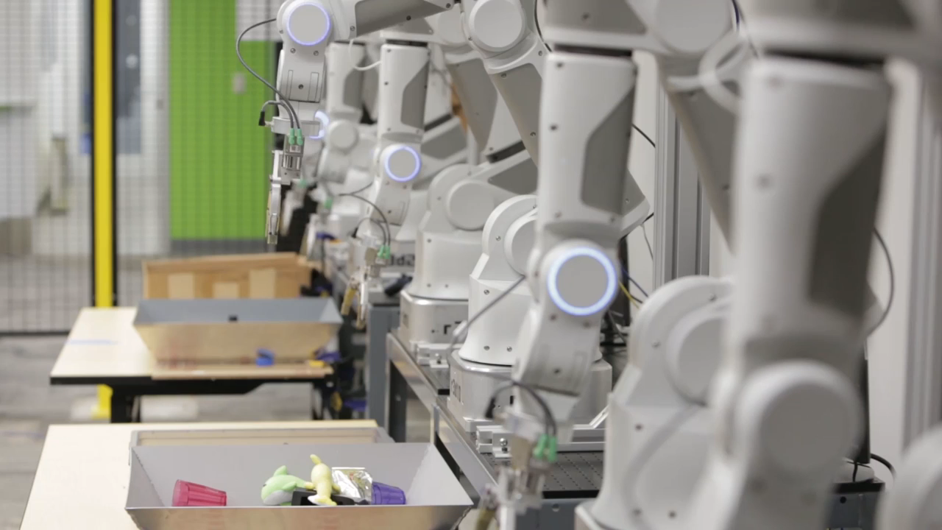

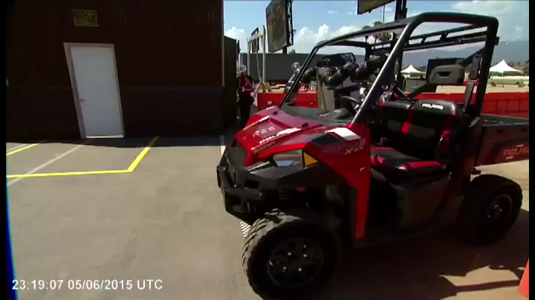
robotics and AI – ECE 448/9

Slide 9
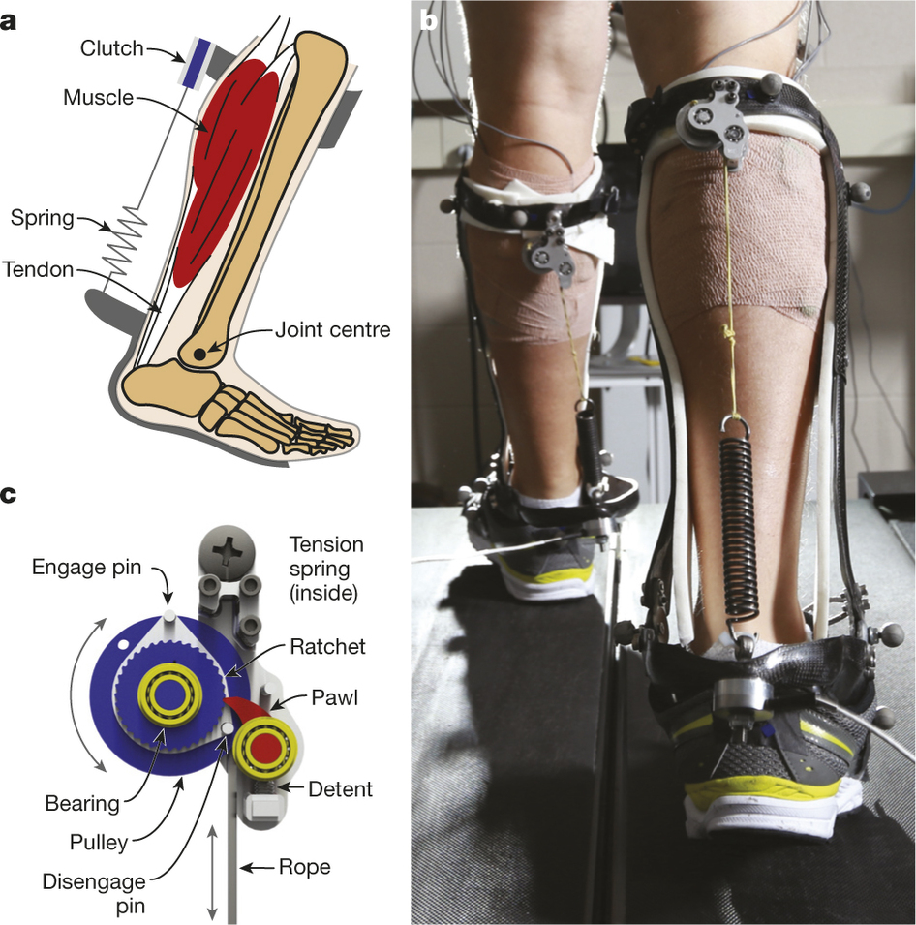
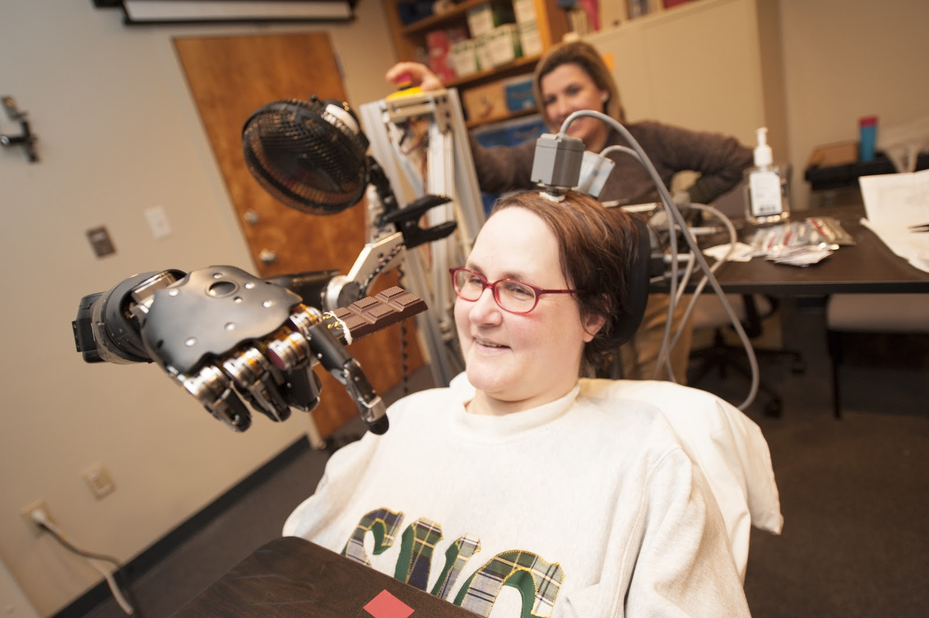
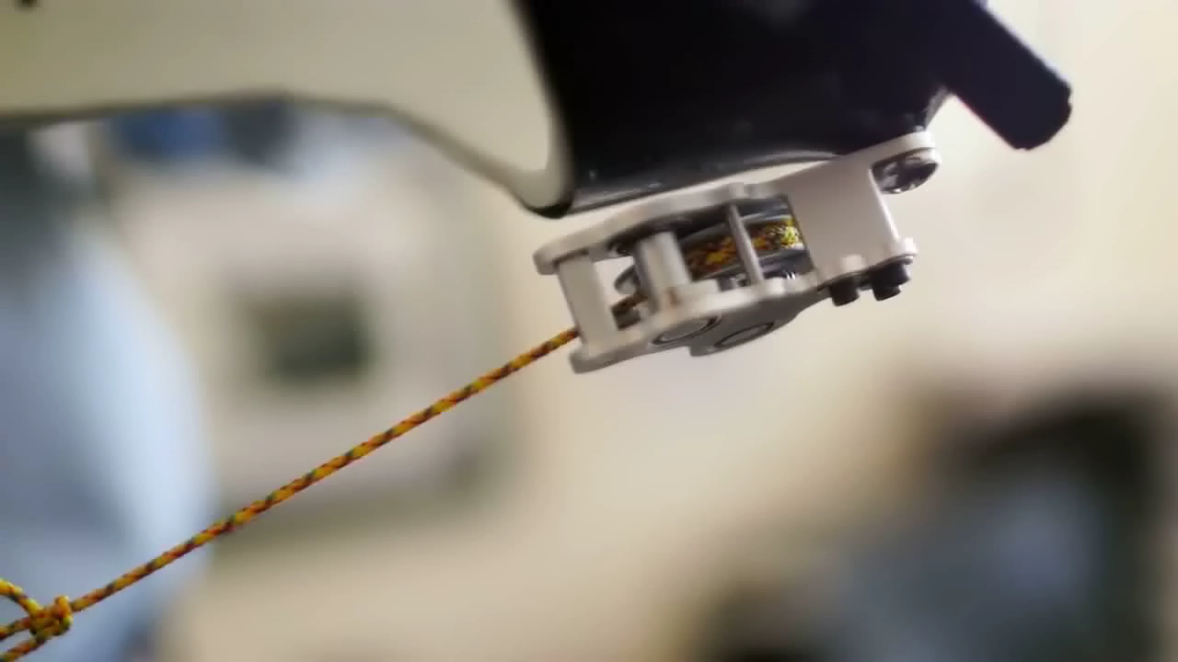

neuroengineering – ECE 466

Slide 10

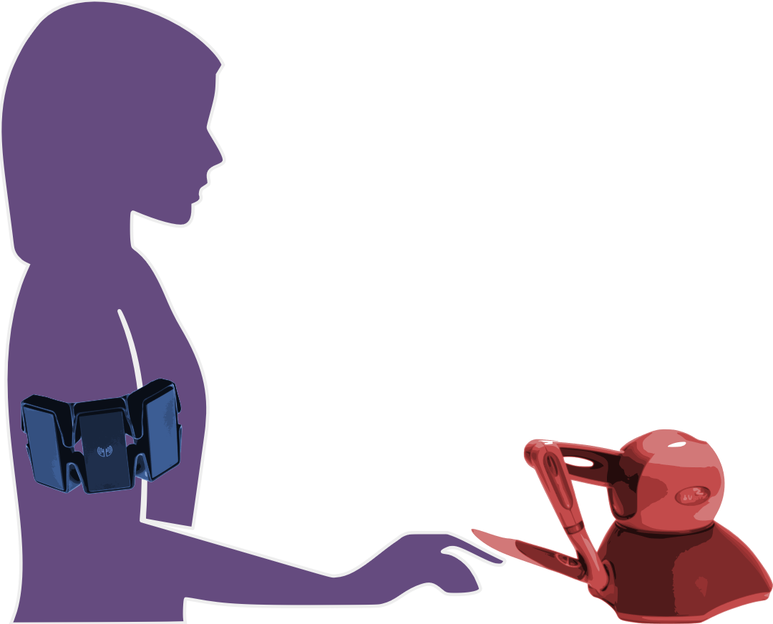
human/machine system:
robot teleoperation
human sensory inputs
human motor outputs
Chiawakum Creek Fire near Lake Wenatchee, WA © Michael Stanford 2015 http://yourshot.nationalgeographic.com/photos/4181903/

Slide 11
human/machine system:
robot teleoperation
human sensory inputs
how do we enable humans to learn and control
contact-rich robot dynamics?
human motor outputs
Chiawakum Creek Fire near Lake Wenatchee, WA © Michael Stanford 2015 http://yourshot.nationalgeographic.com/photos/4181903/

Slide 12
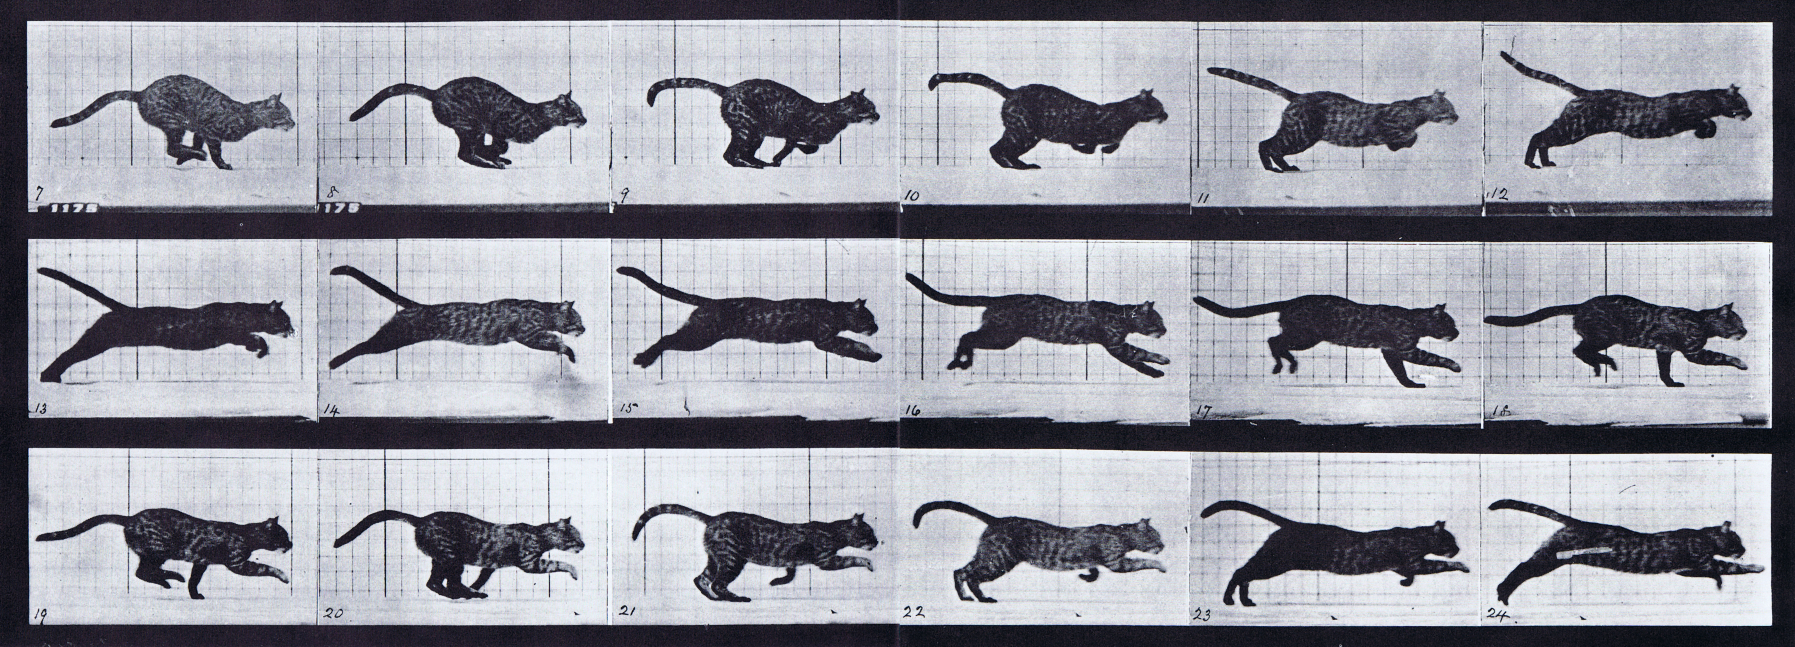

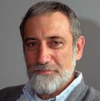
simple models are piecewise-defined (hybrid)
Muybridge 1887 (reprinted by Dover in 1957)
limbs in contact with ground
ground penetration constraints
continuous dynamics
impact dynamics
Johnson, Burden, Koditschek IJRR 2016 (arXiv:1502.01538)
A hybrid systems model for simple manipulation and self-manipulation systems

Slide 13
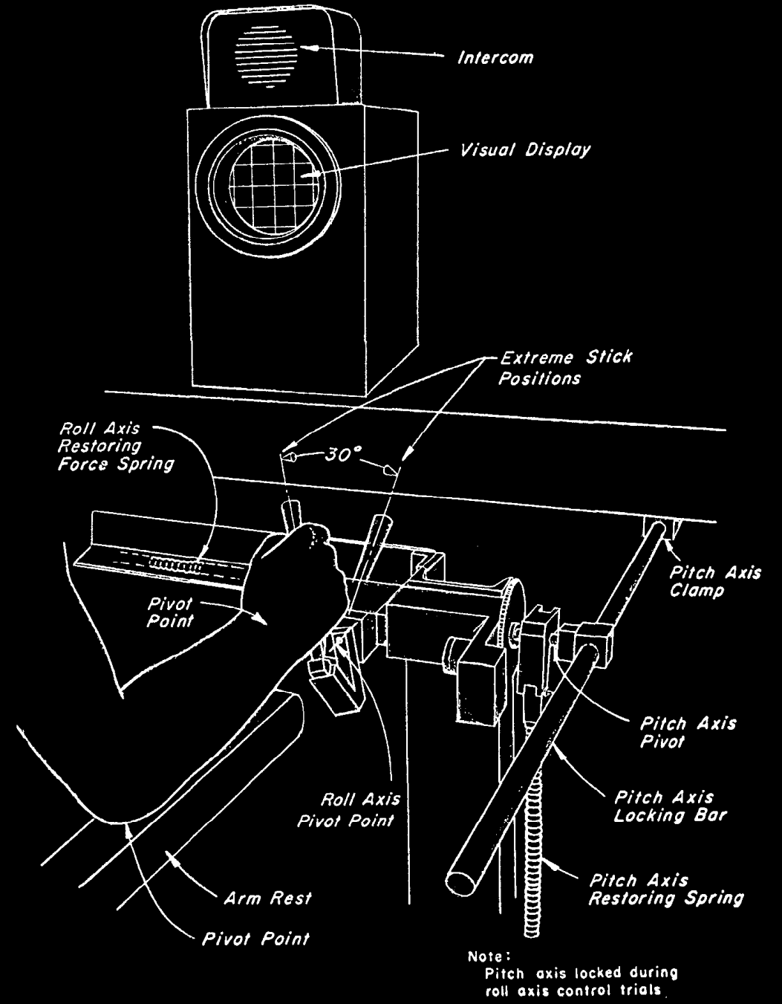
r
d
y
r
reference
y
output
u
disturbance
d
input
u
McRuer, Krendel J Franklin Institute 1959
The Human Operator as a Servo System Element
McRuer Automatica 1980
Human Dynamics in Man-Machine Systems

Slide 14
predicting behavior: what’s in ?
H
human/machine system
H
d
F
f
u
+
+
M
y
e
b
r
+
B
-
McRuer, Krendel J Franklin Institute 1959
The Human Operator as a Servo System Element
McRuer Automatica 1980
Human Dynamics in Man-Machine Systems

Slide 15

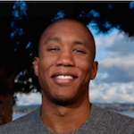

H: humans use feedforward and feedback
human/machine system
feedforward
d
F
f
u
+
+
M
y
e
b
r
+
B
-
feedback
McRuer, Jex IEEE Transactions on Human Factors in Electronics 1967
A Review of Quasi-Linear Pilot Models
Yu, Gillespie, Freudenberg, Cook IEEE CDC 2014
Human control strategies in pursuit tracking with a disturbance input
Yamagami, Howell, Roth, Burden IFAC CPHS 2018
Contributions of feedforward and feedback control in a manual trajectory-tracking task

Slide 16
machine learning and data science

